Slide 1
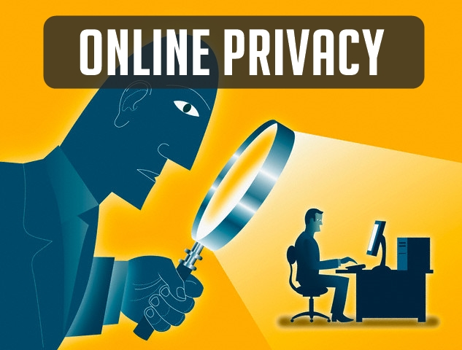
Online Privacy

Slide 2
Definitions & Contexts
Ways in which personal information gets acquired
Online Privacy violation
Why is your online privacy important & is it possible to protect it?
1
2
3
4

Slide 3
Online Privacy
Also known as Internet privacy, it involves the right or mandate of personal privacy concerning the storing, repurposing, provision to third parties, and displaying of information pertaining to oneself via of the Internet, it’s the privacy and security level of personal data published via the Internet. It is a broad term that refers to a variety of factors, techniques and technologies used to protect sensitive and private data, communications, and preferences.

Slide 4
ADVANCING TECHNOLOGY
With internet advancing as fast as it is, and the complexity of the tools to use it ever-growing, it is possible for the everyday user to maintain their own security on the web? How far does one have to delve into the underbelly of the world wide web to obtain the privacy they both want and deserve?

Slide 5
THE POTENTIAL RISKS
The main issue with maintaining privacy on the internet is the fact that there are a number of different ways to access the information necessary to abuse or cause harm to an internet user.

Slide 6
How does our data get acquired?
ISP (Internet Service Providers)
Internet Browsers & Search Engines
Social Media
IM (Instant Messaging)

Slide 7
Online privacy violation

Slide 8
DATA BREACHES
A data breach is a confirmed incident in which sensitive, confidential or otherwise protected data has been accessed and/or disclosed in an unauthorized fashion. Data breaches may involve personal health information (PHI), personally identifiable information (PII), trade secrets or intellectual property.

Slide 9
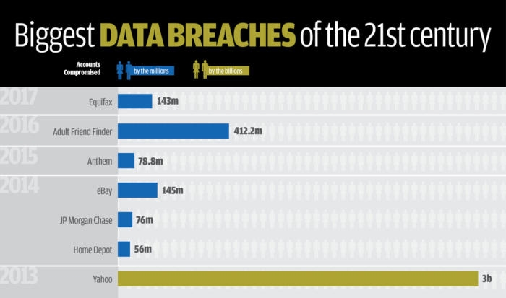
Uber : late 2016, Personal information of 57 million Uber users and 600,000 drivers
exposed.

Slide 10

Racial profiling and user surveillance
Earlier this year, Twitter, Facebook and Instagram were called out by the California branch of the ACLU for sharing user data with a social media monitoring tool that tracks activists’ conversations.. Even worse, the product can be manipulated to target activists of color, which has forced some Black Lives Matter activists off of social media and underground.

Slide 11
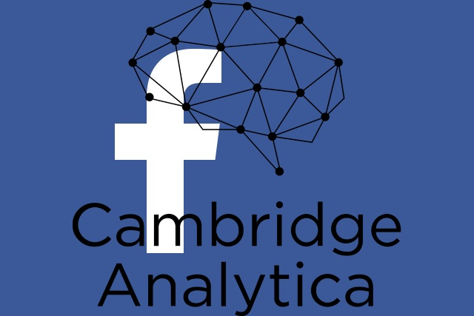
The Facebook–Cambridge Analytica data scandal
it involves the collection of personally identifiable information of up to 87 million Facebook users that Cambridge Analytica began collecting in 2014. The data was used to influence voter opinion on behalf of politicians who hire them

Slide 12
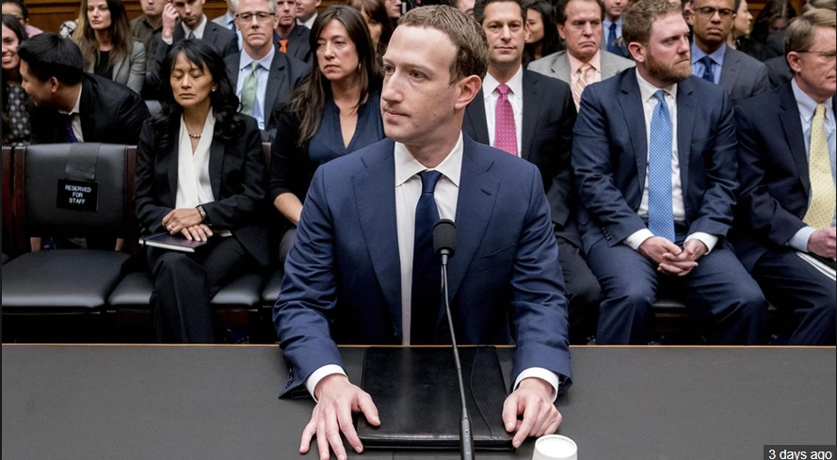
The Facebook–Cambridge Analytica data scandal

Slide 13
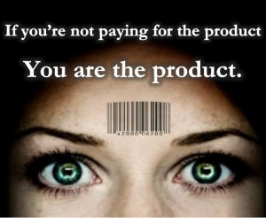
Social Media Business Model
Keeps track of your activities, interests
Reads your conversations
Tracks you on third party websites

Slide 14
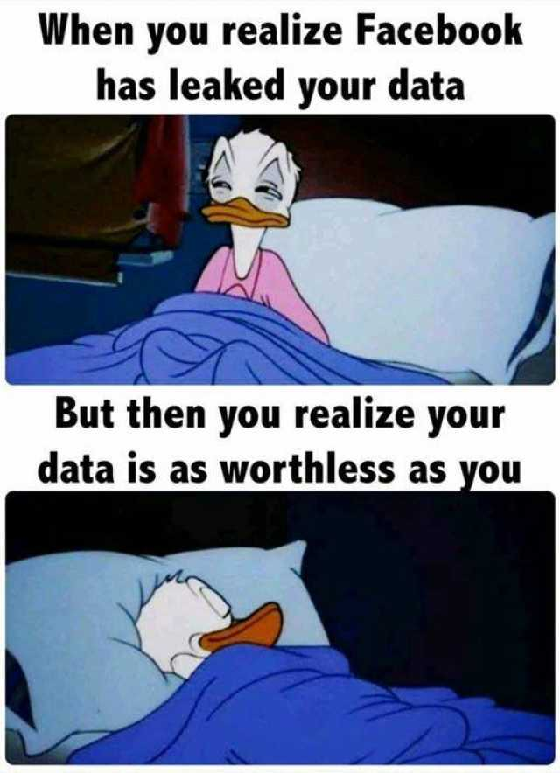
“I have
nothing
To hide.
Why should
I care about
my privacy?”

Slide 15
Why should you care
about your privacy ?
Your privacy is a human right you haven’t always had.
Having nothing to hide is not true nor realistic.
Information in the wrong hands becomes dangerous.
You can’t predict the future.

Slide 16
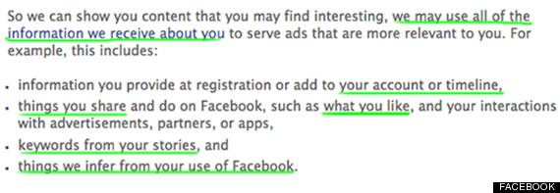
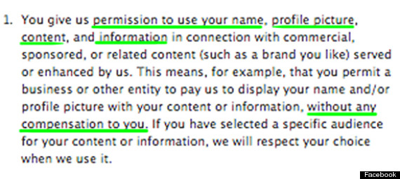
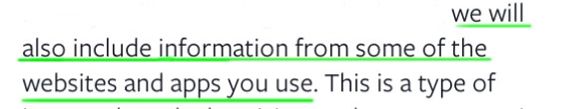
Can you prevent your privacy from being violated?
It’s difficult, they already have the permission to do so.

Slide 17
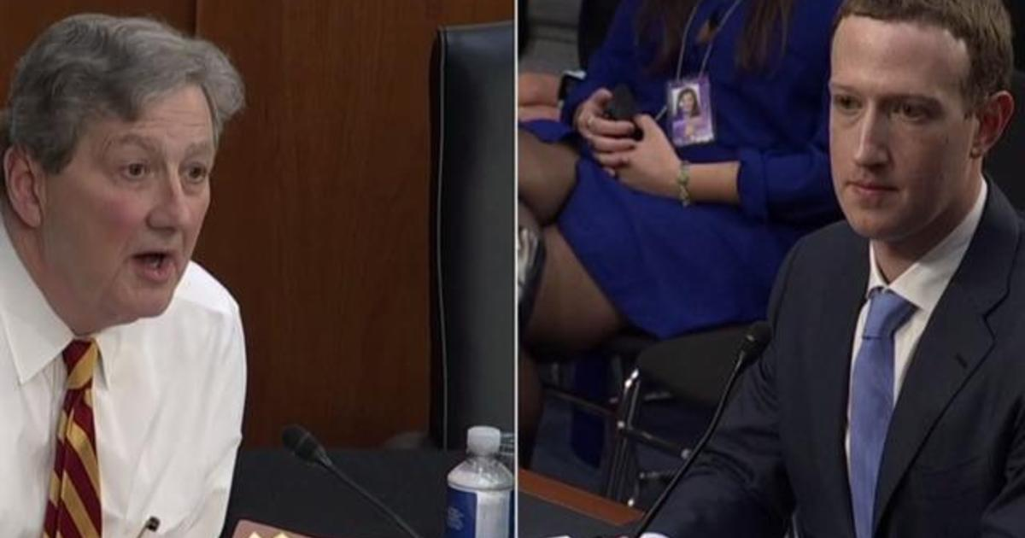
Can you prevent your privacy from being violated?
"Here's what everyone's been trying to tell you today — and I say it gently — your user agreement sucks," Senator Kennedy said. "The purpose of a user agreement is to cover Facebook's rear end, not inform users of their rights."

Slide 18
Can you prevent your privacy from being violated?
Facebook apologies list :
2006: “We really messed this one up.”
2007: “We simply did a bad job. I apologize for it.”
2010: “Sometimes we move too fast.”
2011: “I’m the first to admit we’ve made a bunch of mistakes.”
2017: “I ask for forgiveness. I will work to do better.”
Limit the data you give away!

Slide 19
Thank you!
Shouldn’t we care more about protecting our online privacy?
Would you dare to #deletefacebook for the sake of your privacy?

